Slide 1
An Insight Extraction System on BioMedical Literature with Deep Neural Networks Hua He, Kris Ganjam, Navendu Jain, Jessica Lundin, Ryen White and Jimmy Lin
Department of Computer Science, University of Maryland College Park
huah@cs.umd.edu Microsoft
{krisgan,navendu,jelundin,ryenw}@microsoft.com Cheriton School of Computer Science, University of Waterloo
jimmylin@uwaterloo.ca

Slide 2
Introduction
Two major processing tasks performed on the biomedical text :
identify and classify biomedical entities (NER) into predefined categories.
infer pair-wise relationships among named entities.
This paper presents a system that processes biomedical text to extract two specific types of relationships among biomedical entities:
Cause effect
Correlation.

Slide 3
Introduction
We map the extraction task into a representational similarity measurement task in the vector space.
Our approach innovates in that it explicitly measures both relational and contextual similarity among representations of named entities, entity relations and contexts.
Our system also provides a novel combination of recognizing named entities, predicting relationships (insights) between extracted entities, and ranking the output.

Slide 4
Contribution
We build an end-to-end system to extract insights from biomedical literature.
We innovate in similarity measurement modeling with deep neural networks for better causality/correlation relation extraction.
Our human evaluation show our system can achieve competitive acceptance accuracy.

Slide 5
Related Work
Most previous work in BioNLP focused on extraction of biomedical concepts such as drug or protein names.
Feature engineering was the dominant approach in most biomedical relation extraction work with machine learning techniques.
Our work instead propose neural network models that do not require sparse features as in most previous work.
Our approach is inspired by recent embedding learning work to jointly represent texts and knowledge base, previous work on embedding transfer learning and noise contrastive estimation.
Our work models insight extraction as a similarity measurement problem, and is inspired by similarity measurement work on pairwise word interaction modeling with deep neural networks.

Slide 6
System Overview
we firstly look for all named entities using a shallow parser and public medical dictionaries.
our neural network-based relation extractor checks if a valid causality/correlation relationship exists.
each valid entity pair is scored via the ranking component .
the system returns top ranked insight(s) to users.

Slide 7
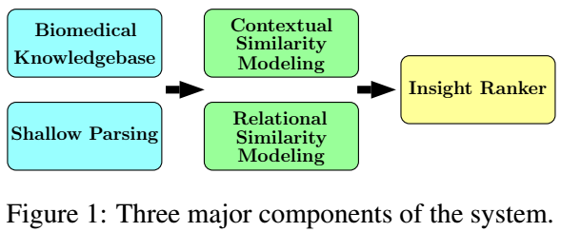
System Overview
The system consists of three major neural network-based components
a named entity extractor
a causality/correlation relation extractor
an insight ranker

Slide 8
Named Entity Extraction
Most existing off-the-shelf biomedical entity recognizers narrowly focus on specific biomedical terms.
We design an entity extractor by using both an in-domain medical knowledge base for keyword matching, and a domain-independent neural network-based shallow parser for entity boundary detection.
We firstly use a large public dictionary, Metathesaurus of UMLS to obtain in-domain biomedical terms (Using Aho-Corasick).
We also use a neural network-based shallow parser to identify boundaries of general noun phrases to improve system recall, which are not limited to biomedical terms.
If entity overlaps exist, only phrases with longest matching sequence are extracted.

Slide 9
Relation Extraction as Similarity Measurement
If a causality/correlation relationship holds between two named entities, then representations of the two entities should be semantically similar and close to the representation of the relation in a low-dimensional vector space.
Relational similarity between entities and relation
Contextual similarity between entities and sentence context

Slide 10
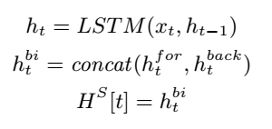



Context Modeling
Different words occurring in similar contexts should have a higher chance to contribute to similarity measurement and relation extraction.
We use bidirectional LSTMs (BiLSTM) for context modeling as a basis for all following models.
Given named entity positions of the sentence, we get and from context .

Slide 11





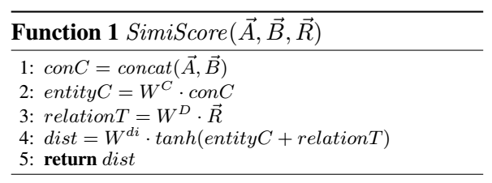
Relational Similarity Modeling
Relational similarity modeling focuses on interactions between named entities and relations in the vector space.
Objective function
A similarity measurement function with learnable weights returns a similarity score representing how semantically close are.

Slide 12


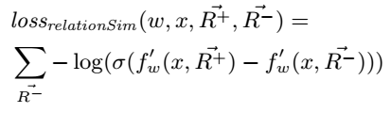
Relational Similarity Modeling
Our goal is to learn a function so that the positive triplet is assigned a larger score than that of the negative triplet :
Loss function: Bayesian Personalized Ranking (BPR) loss

Slide 13
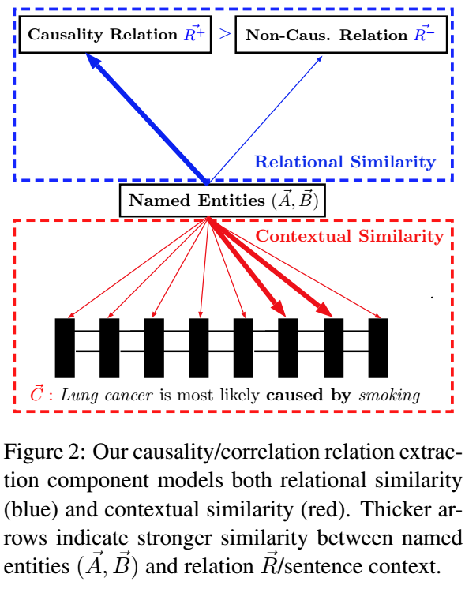
Relational Similarity Modeling

Slide 14
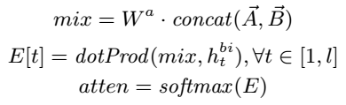

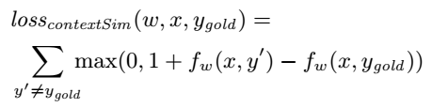
Contextual Similarity Modeling
A contextual similarity model that can increase model weights onto important context words —— an attention mechanism.
the attention re-weighted sentence representation
Loss function: hinge loss

Slide 15
Ranking of Extracted Insights
there could be many extracted relations but not all of them are important enough as insights of the article.
Utilize the output classification probability of the relational similarity model as the base ranking score.
Use a MPCNN(多视角卷积神经网络) to measure the similarity (∈ [0,1]) between the title of the article and extracted relation. We compare title text with “ leads to ” of an extracted relation, if the similarity score is over a threshold of 0.75, we increase the extracted relation’s ranking score by 15%. If the extracted relation is from the title text, we also boost its ranking score by 15% because of its location importance.

Slide 16
Experiment Setup
Data set:
Our own dataset of medical/health publications annotated on Universal Human Relevance System (UHRS).
SemEval-2010 task 8 dataset for training and evaluation of our relation extraction component.
Settings and Preprocessing.
λ = 0.0001
The momentum parameter is 0.9
LSTM hidden state dim = 500
Word embeddings d = 300-dimension

Slide 17
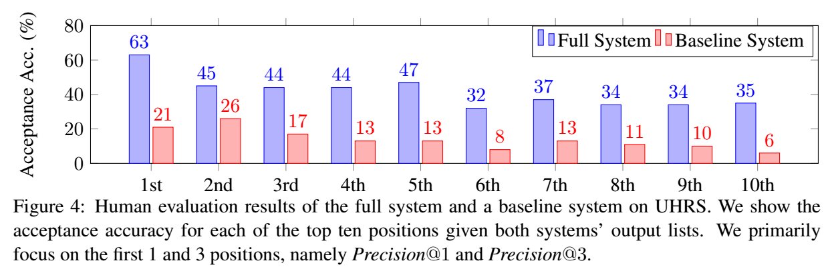
Evaluation and Results
Human Evaluation of the Entire System

Slide 18
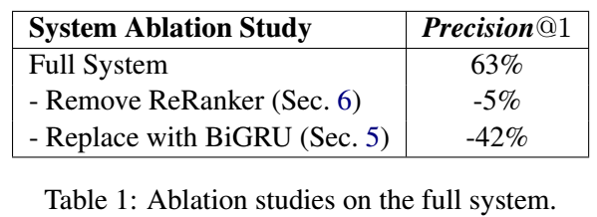
Evaluation and Results
Human Evaluation of the Entire System

Slide 19
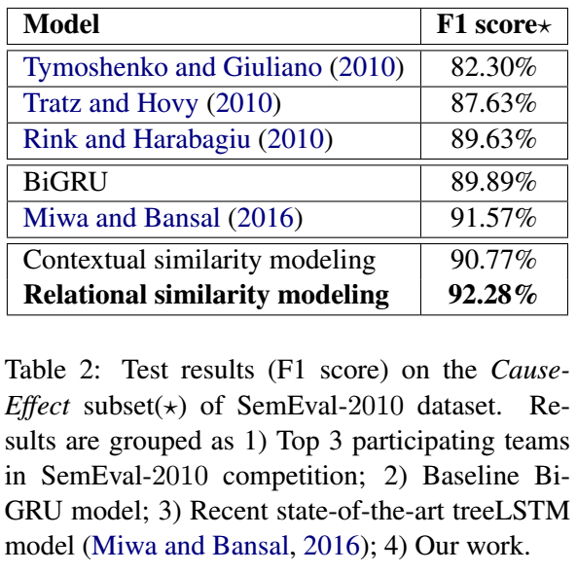
Evaluation and Results
Evaluation of Relation Extraction Component

Slide 20
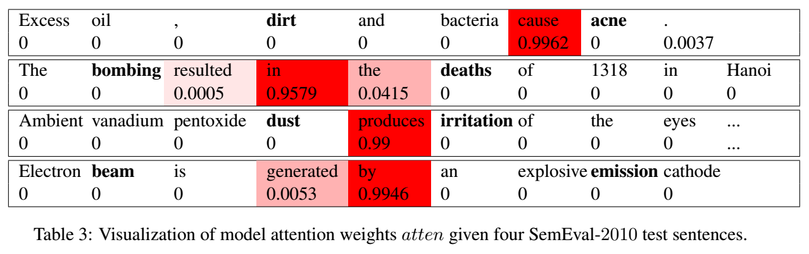
Result Analysis and Case Study
Visualization of Contextual Similarity Model.

Slide 21
Conclusion
Build an end-to-end system for insight extraction on biomedical literature.
Develop novel similarity measurement modeling with deep neural networks to extract causation/correlation relations.
Evaluation shows the system is able to extract insights with competitive human acceptance accuracy and its relation extraction component compares favorably against previous work.

Slide 22
Thank you!

